Slide 1

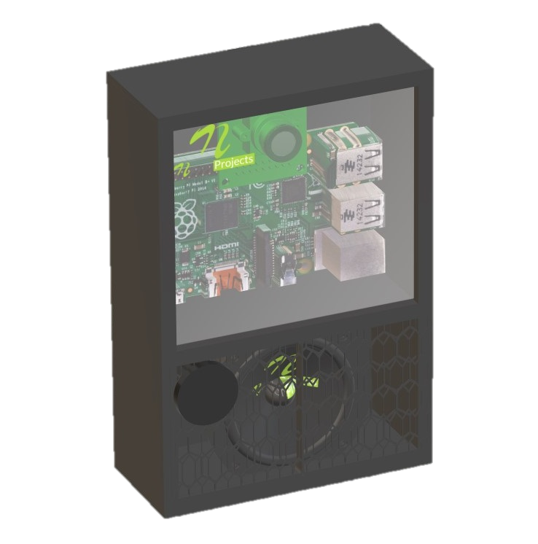

VIDYA PRATISHTHAN'S KAMALNAYAN BAJAJ INSTITUTE OF ENGINEERING AND TECHNOLOGY, BARAMATI
DEPARTMENT OF ARTIFICIAL INTELLIGENCE AND DATA SCIENCE
IOT DOOR BUZZER & HOME SECURITY DEVICE
YASHRAJ DEVRAT 2127011
SHUBHAM KESKAR 2127029
AVDHOOT KUMBHAR 2127037
TUSHAR MAMADGE 2127040

Slide 2
CONTENTS :
INTRODUCTION
OBJECTIVE
COMPONENTS
LITERATURE REVIEW
SYSTEM ARCHITECTURE
SYSTEM IMPLEMENTATION
APPLICATIONS
ADVANTAGES
DISADVANTAGES
TESTING AND RESULTS
CONCLUSION

Slide 3
Introduction
We live in the 21st century where everything is preferred to be fast contactless and automated. COVID has even more increased the need for contactless systems. Well here we propose a contactless doorbell as well as safety system using IOT for automatic visitor recognition and alerting home owner.
The contactless doorbell uses a raspberry pi controller to work along with a camera module and speaker to perform automatic operations. This system will help home owner know who has arrived at his/her door as well as it will act as a security system when the owner is not at home to alert on any robbery.

Slide 4
Objective
The objective of this project is to facilitate the user with a simple and customised technology to effectively manage visitors flowing to his/her premises. It is a real time smart doorbell notification system for home security.
The system combines the functions of a smart and a house network system. It enables the users to monitor visitors in real time via the IOT based doorbell installed near the entrance door to a house.

Slide 5
Components
Raspberry Pi
Camera Module
Wifi Module
Speaker
LCD Display
Ultrasonic Sensor
Resistors
Capacitors
Buttons & Switches
Electrical & Wirings
PCB Board
Diodes Transistors
Connectors
Screws and Fittings

Slide 6
LITERATURE REVIEW
The system, ‘Home Security System for Alone Elderly People’, is a project which was implemented in Thailand. It is in the aging society because the number of elderly population is more than 10 percent and keeps increasing every year, while the household size is decreasing.
As a consequence, more elderly people have to live alone. Moreover, there are more than 10 percent of elderly's accidents occurred each year

Slide 7
SYSTEM ARCHITECTURE
The system architecture diagram includes the main components, the Doorbell, Smart Doorbell System, Wireless transmitter-receiver module and LCD Response.
The data flow diagram shows the back end of the system. It shows the process and flow of data when the doorbell is pushed and how the visitor receives a LCD response.

Slide 8
HARDWARE REQUIREMENTS: | SOFTWARE REQUIREMENTS:
Arduino Mega | Arduino IDE
Ethernet Shield | Pushinbox API
Doorbell/Switch | -
Jumper cables | -
Ethernet cable Software | -

Slide 9
System Architecture Chart
SMART DOORBELL
SYSTEM
VISITOR
DOORBELL
WIRELESS TRANSMITTER RECEIVER MODULE
LCD RESPONSE
SMS NOTIFICATION

Slide 10
SYSTEM IMPLEMENTATION
The list of modules that are being implemented are given below:
Configuration of Arduino board and Ethernet Shield.
Connecting Arduino to Doorbell.
Wireless Transmitter-Receiver module.
API to send SMS notification.
Response to visitor API

Slide 11
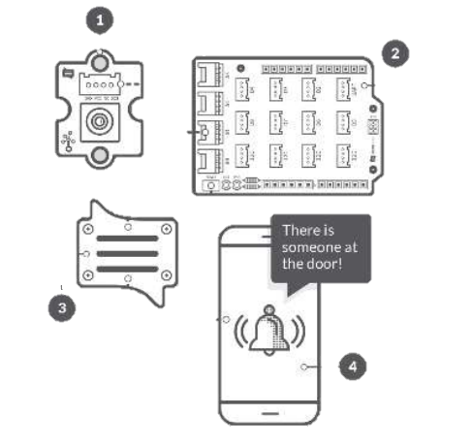
Diagrammatic Representation Of Module Flow

Slide 12
Applications
House & Bungalows
Offices
Apartments
Farmhouses

Slide 13
Advantages
Automatic Visitor Recognition
Voice Assisted Interface
Instant Online Alerts on Desktop/Mobile
Ability to Sound Alarm at remote Location
Monitor Activity Outside the House at any Time
Fully Automated System

Slide 14
Disadvantages
The arriving person cannot talk to owner
Cannot open the door remotely
Doesn’t auto detect robbery inside home

Slide 15
TESTING AND RESULTS
As we performed testing under various cases and the outcomes of test cases are recorded and listed below :
Scenario | Test Type | Outcome
Under different weather conditions | Sensor test | Works perfectly in all weather conditions
When visitor rings the bell | Visitor Arrival Test | Bell rings, SMS is received by owner after 3 minutes
Waiting time | Message transmission reception test | Acknowledgement by owner was displayed on the LCD screen

Slide 16
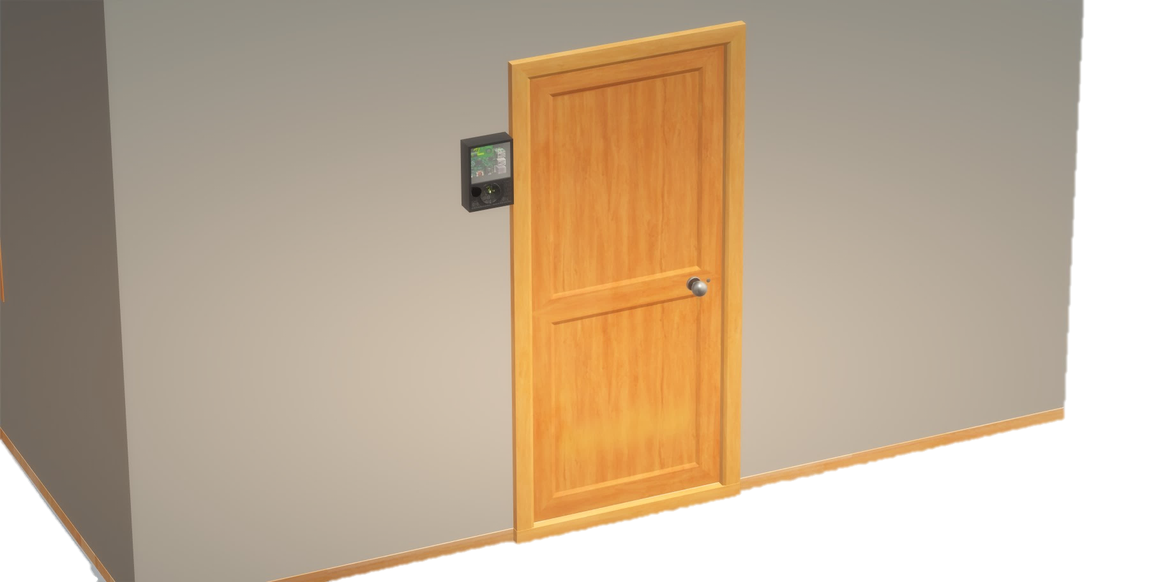
DESIGN IMAGE

Slide 17
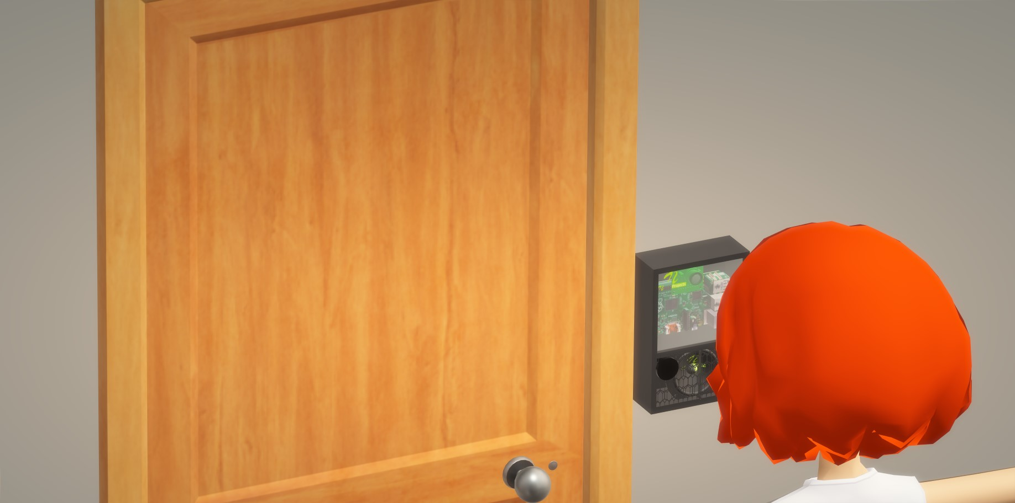
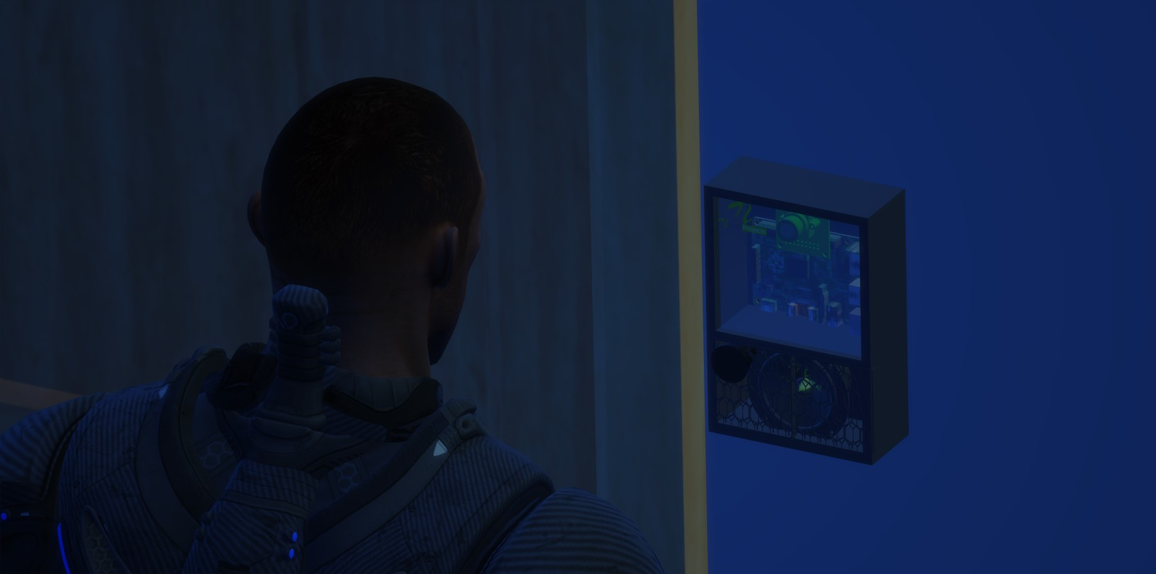
DAY MODE
NIGHT MODE

Slide 18
CONCLUSION
The project named "Smart IOT Doorbell Surveillance" has been designed with the domain as Internet of Things .
The basic concepts and working of IOT has been displayed in the running of the project . The project uses mainly an Arduino Board and OOPS programming concept .
Since, today, in a technologically enhancing environment, security issues is of utmost concern , this project shows how technology can be used to enhance the security features of people's homes .

Slide 19
Acknowledgments
I sincerely express my heartfelt gratitude and appreciation to my supervisor Mr. Sahil Shah Sir , Department of Artificial Intelligence and Data Science for their supervision and guidance during the whole semester . I am greatly indebted to group members and for their constant support and helpful nature . It is my pleasure to acknowledge my colleagues .

Slide 20


